Slide 1
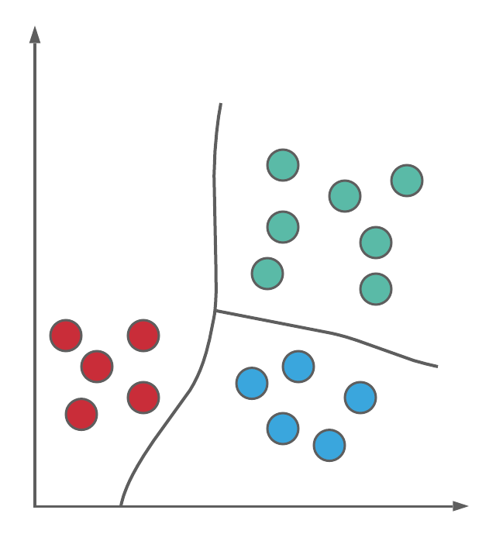
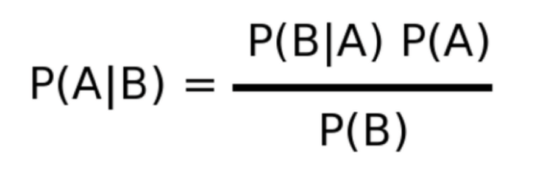
Naive Bayes Classifier

Slide 2
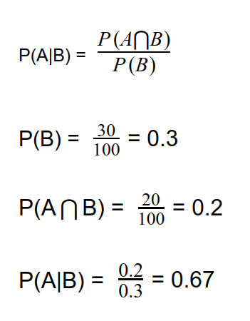
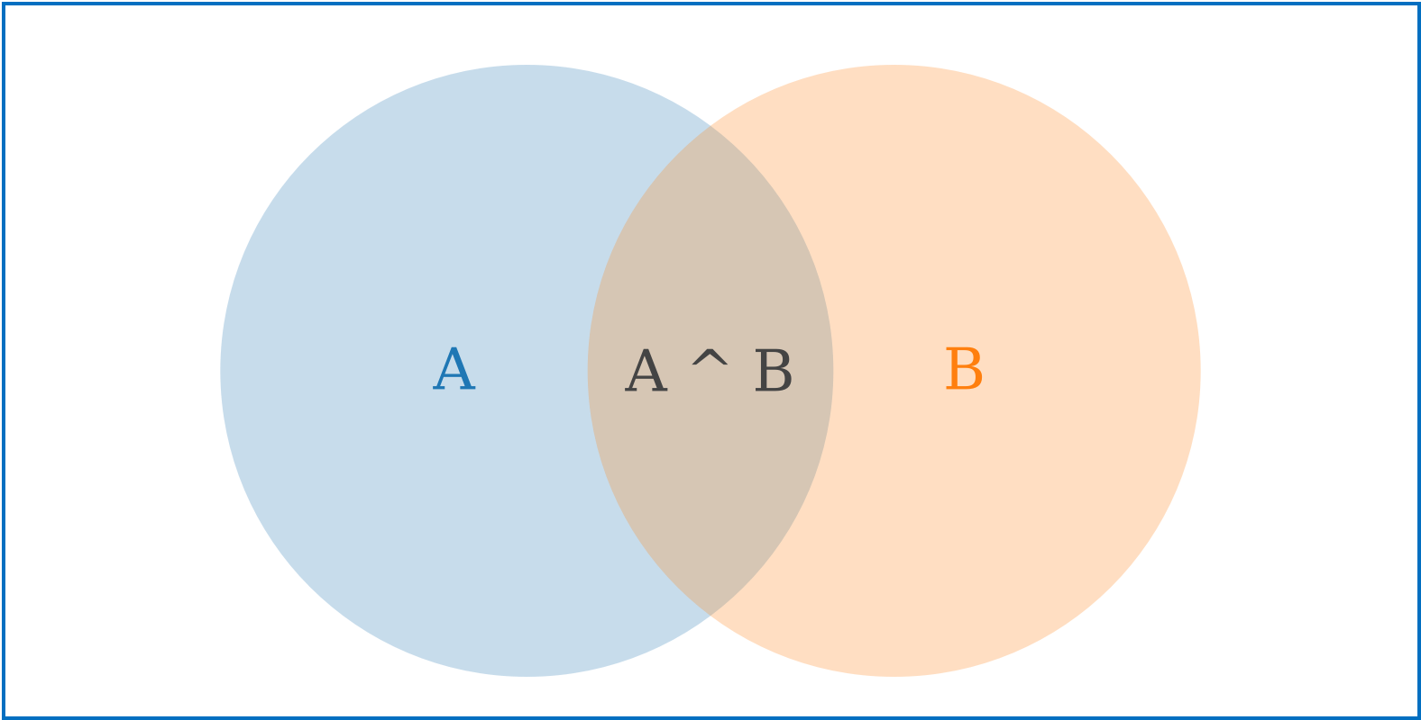
Conditional Probability
20
40
30

Slide 3
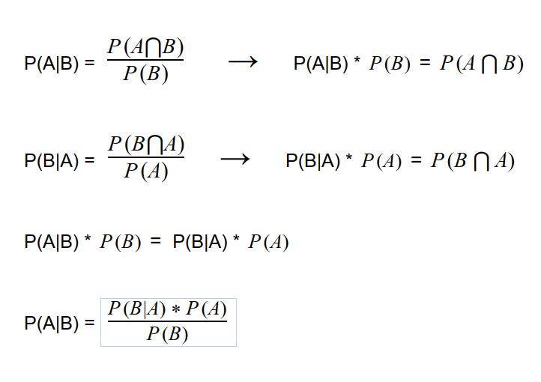
Bayes Theorem

Slide 4
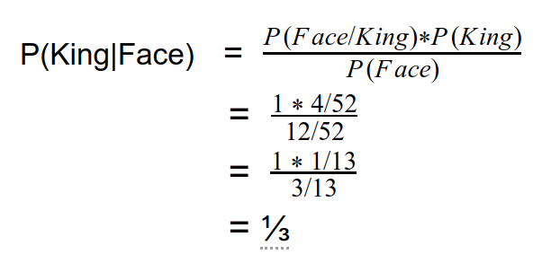
Example

Slide 5
Fruit = { Yellow, Sweet, Long }
Fruit | Yellow | Sweet | Long | Total
Orange | 350 | 450 | 0 | 800
Banana | 400 | 300 | 350 | 400
Others | 50 | 100 | 50 | 150
Total | 800 | 850 | 400 | 1200

Slide 6
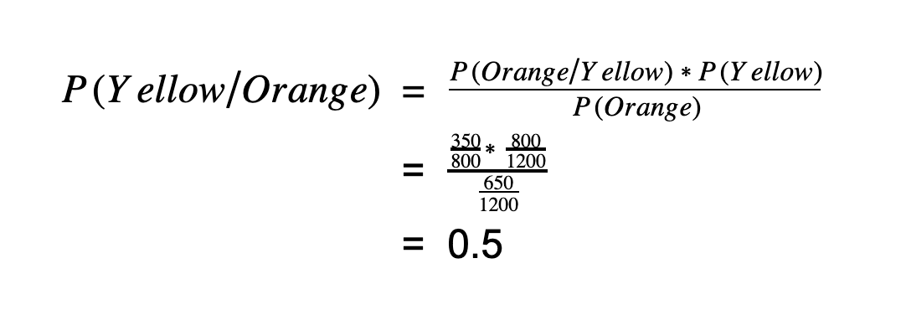
Fruit | Yellow | Sweet | Long | Total
Orange | 350 | 450 | 0 | 650
Banana | 400 | 300 | 350 | 400
Others | 50 | 100 | 50 | 150
Total | 800 | 850 | 400 | 1200

Slide 7
P(Yellow/Orange) = 0.5
P(Sweet/Orange) = 0.69
P(Long/Orange) = 0
P(Fruit/Orange) = P(Yellow/Orange) * P(Sweet/Orange) * P(Long/Orange)
= 0.5 * 0.69 * 0 = 0
P(Fruit/Banana) = 0.65
P(Fruit/Others) = 0.072
Result: Banana

